Slide 1
How to Use
Kubernetes/minikube

Slide 2
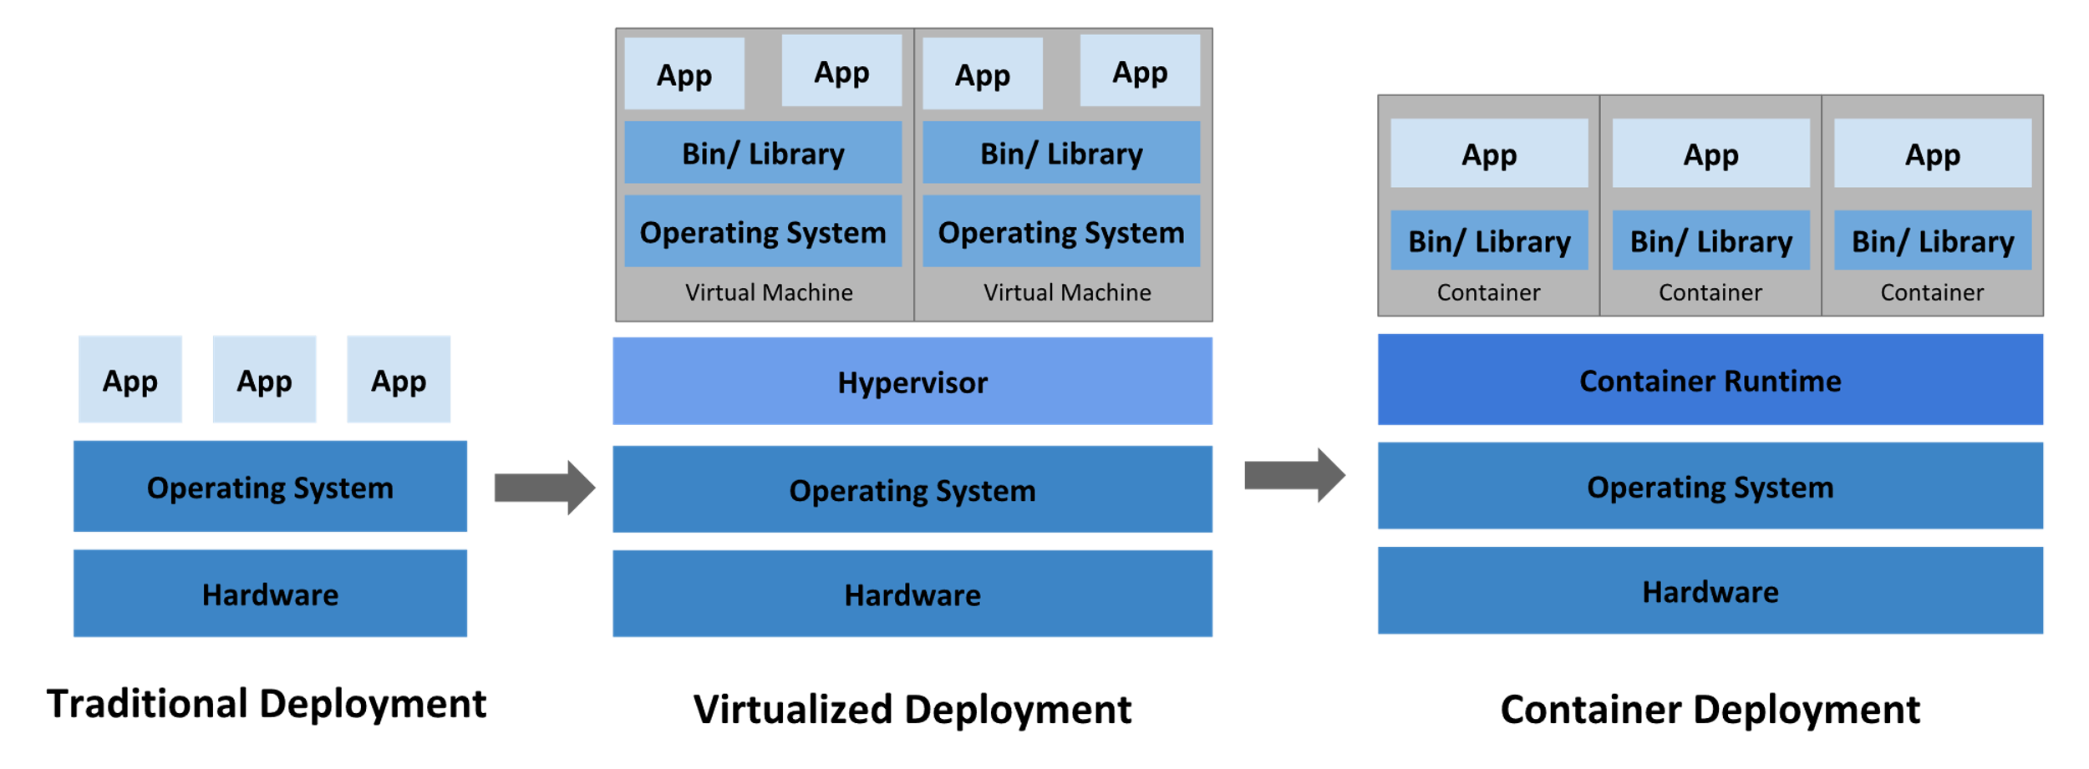
Kubernetes/minikube – Key Aspects
What is?
A lightweight implementation of K8S open-source platform for managing containerized application workloads and services in distributed systems resiliently. It facilitates both configuration and automation aiming to implement a large, rapidly growing ecosystem.
How?
In short words, It facilitates deployment (i.e.: as canary) and management of containers in a clustered environment.
Why?
It removes traditional operational efforts for deployment and management, avoid unneeded resources expenditure with OS and binaries of virtualized environments and lowers deployment setup time in standardize work environments.
Traditional env
Virtualized env
Containerized env
https://kubernetes.io/docs/concepts/overview/what-is-kubernetes/
https://kubernetes.io/docs/concepts/

Slide 3
Kubernetes/minikube – Install
Check for virtualization support
grep -E --color 'vmx|svm' /proc/cpuinfo (** if not empty, it is available)
Install Kubectl
Latest release
curl -LO https://storage.googleapis.com/kubernetes-release/release/`curl -s https://storage.googleapis.com/kubernetes-release/release/stable.txt`/bin/linux/amd64/kubectl
Specific release
curl -LO https://storage.googleapis.com/kubernetes-release/release/v1.16.0/bin/linux/amd64/kubectl
Make executable and from the right place
chmod +x ./kubectl
sudo mv ./kubectl /usr/local/bin/kubectl
Install using native package management
sudo apt-get update
sudo apt-get install -y apt-transport-https
curl -s https://packages.cloud.google.com/apt/doc/apt-key.gpg | sudo apt-key add -
echo "deb https://apt.kubernetes.io/ kubernetes-xenial main" | sudo tee -a /etc/apt/sources.list.d/kubernetes.list
sudo apt-get update
sudo apt-get install -y kubectl
https://kubernetes.io/docs/tasks/tools/install-kubectl/#install-kubectl-on-linux

